Slide 1
Plant responses to temperature over space and time

Slide 2
Class questions
How does temperature vary over space and time?

Slide 3
Class questions
How does temperature change in natural environments?
Why does temperature variation matter for plants?

Slide 4
Processes that respond to temperature: Enzymatic potential

Slide 5
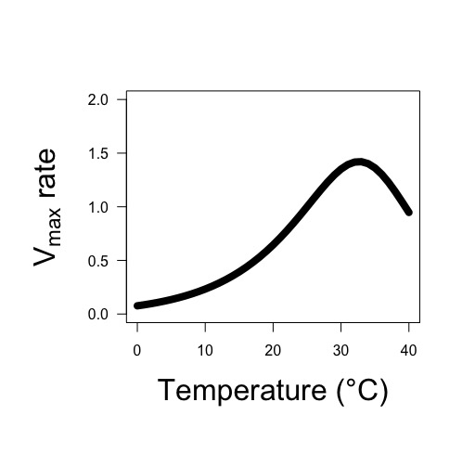
Enzyme rate (Vmax) is the result of both the activation rate and deactivation rate
Leads to a peaked exponential response

Slide 6
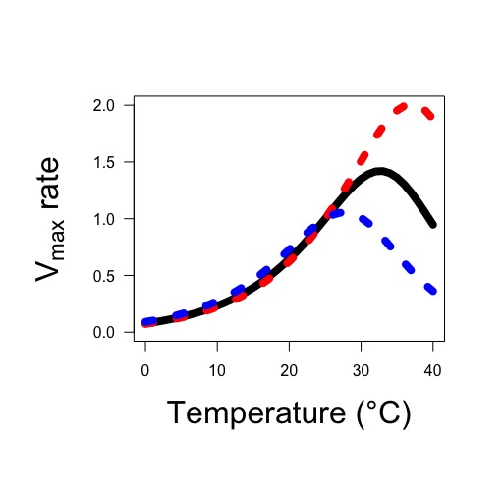
This peak may change based on acclimation
Red = warm acclimated
Blue = cold acclimated

Slide 7
Processes that respond to temperature: Substrate affinity

Slide 8
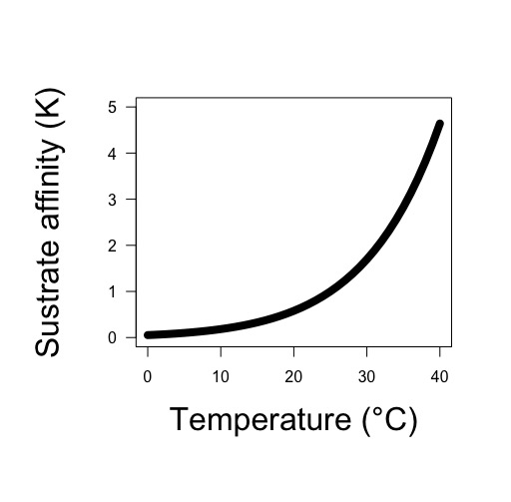
Substrate affinity increases with temperature
The change is dependent on the substrate and enzyme

Slide 9
Processes that respond to temperature: Diffusion

Slide 10
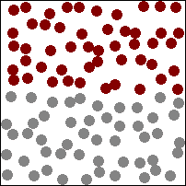
Diffusion: movement from area of low concentration to high concentration

Slide 11
Diffusion rates increase with temperature (Fick’s law coefficient increases)

Slide 12
Class questions
How does temperature change in natural environments?
Why does temperature variation matter for plants?

Slide 13
Respiration and temperature

Slide 14
Respiration and temperature
Enzymatic rates increase with T
Substrate affinity increases with T

Slide 15
Respiration and temperature
Enzymatic rates increase with T
Substrate affinity increases with T
What should the response look like?

Slide 16
Photosynthesis and temperature

Slide 17
Photosynthesis and temperature
Enzymatic rates increase with T
Substrate affinity increases with T

Slide 18
Photosynthesis and temperature
Enzymatic rates increase with T
Substrate affinity increases with T
What should the response look like?

Slide 19
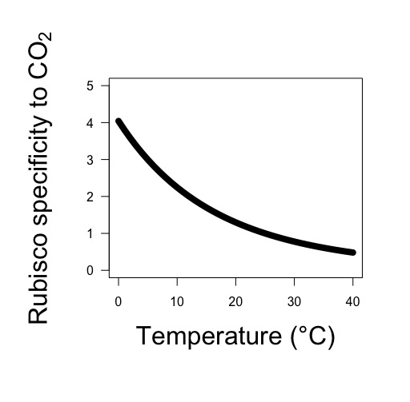
Photosynthesis and temperature
Enzymatic rates increase with T
Substrate affinity increases with T
Rubisco likes O2 more at higher T!

Slide 20
Photosynthesis and temperature
Enzymatic rates increase with T
Substrate affinity increases with T
Rubisco likes O2 more at higher T!
What should the response look like?

Slide 21
Transpiration and temperature

Slide 22
Transpiration and temperature
Diffusion rates increase with T

Slide 23
Transpiration and temperature
Diffusion rates increase with T
What should the response look like?

Slide 24
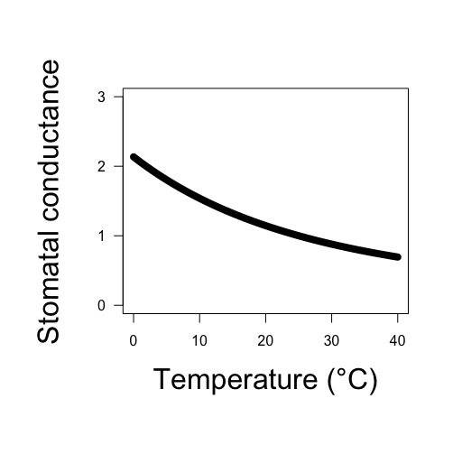
Transpiration and temperature
Diffusion rates increase with T
Stomata close with increased T!

Slide 25
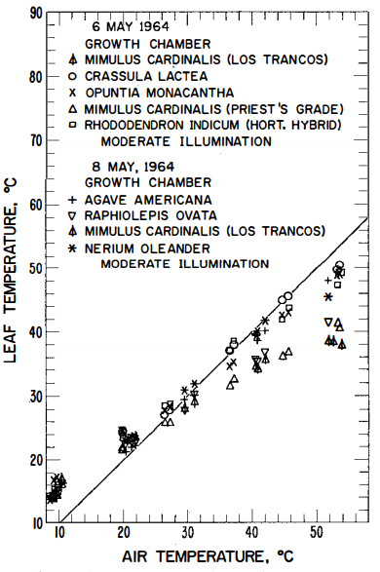
Transpiration and temperature
Diffusion rates increase with T
Stomata close with increased T!
Leaves cool with increased T!
Gates (1968)

Slide 26
Transpiration and temperature
Diffusion rates increase with T
Stomata close with increased T!
Leaves cool with increased T!
What should the response look like?

Slide 27
Does this influence your thinking on photosynthesis-temperature responses?

Slide 28
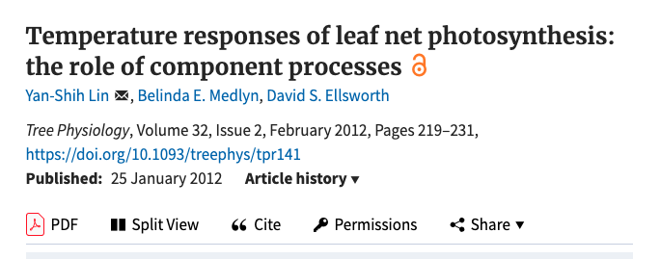

Slide 29
Photosynthesis and temperature
Enzymatic rates increase with T
Substrate affinity increases with T
Rubisco likes O2 more at higher T!
Stomata close at higher T!
What should the response look like?

Slide 30
Photosynthesis and temperature
Enzymatic rates increase with T
Substrate affinity increases with T
Rubisco likes O2 more at higher T!
Stomata close at higher T!
Would this differ for C4 species?

Slide 31
But now what about acclimation!

Slide 32
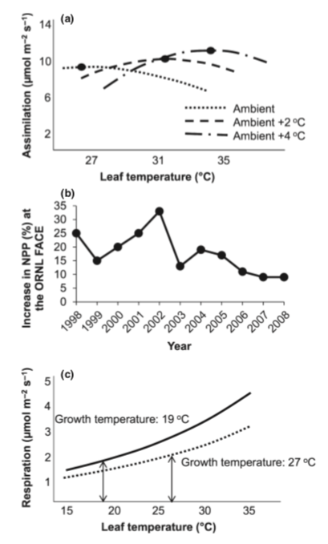
Acclimation leads to a roughly homeostatic response!
Gunderson et al. (2010)
Silim et al. (2010)

Slide 33
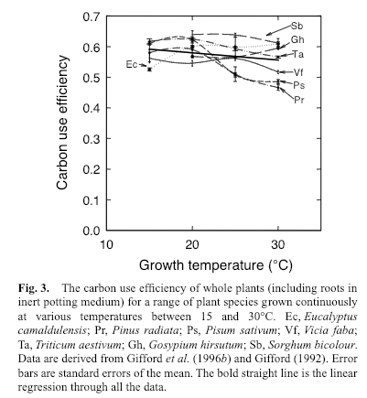
CUE = photosynthesis / respiration
Gifford (2003)

Slide 34
Class questions
How does temperature change in natural environments?
Why does temperature variation matter for plants?
Does any of this even matter?

Slide 35
Will a 3-5°C increase in temperature matter? Why or why not?
IPCC (2013)

Slide 36
Will a 3-5°C increase in temperature matter? Why or why not?

Slide 37
Thermal acclimation and the dynamic response of plant respiration to temperature
Atkin and Tjoelker (2003). Trends in Plant Science

Slide 38
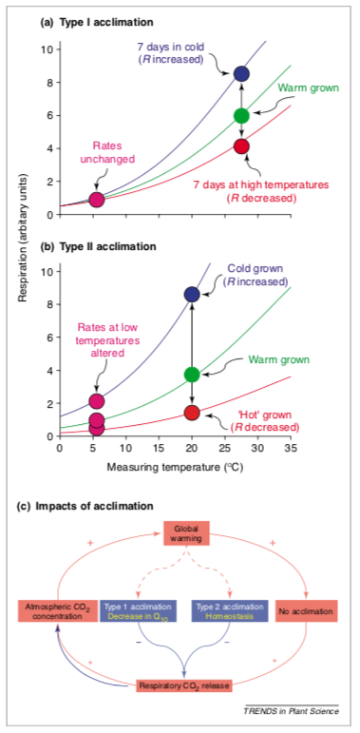
Temperature acclimation: Seems pretty cut and dry!
Atkin & Tjoelker (2003)

Slide 39
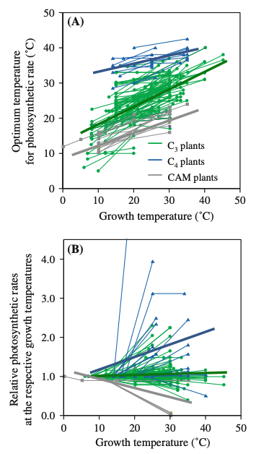
It turns out acclimation can be quite variable
Yamori et al. (2014)

Slide 40
Given what you know about temperature responses: Why would plants acclimate?

Slide 41
Why wouldn’t they?

Slide 42
Figures for ease of viewing

Slide 43
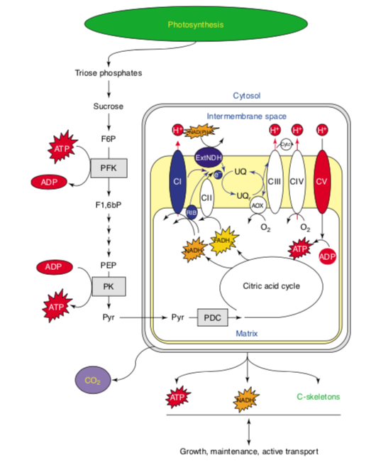

Slide 44
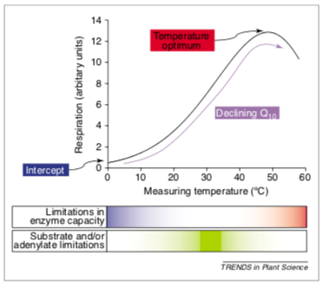

Slide 45
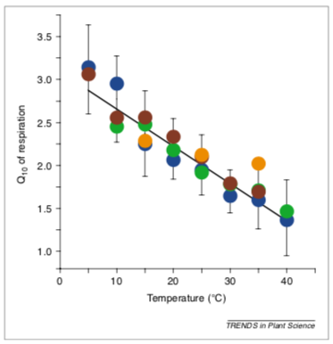

Slide 47
